Slide 1

Linear Programming: Computer Solution and Sensitivity Analysis
Chapter 3

Slide 2
Chapter Topics
Computer Solution
Sensitivity Analysis

Slide 3
Computer Solution
Early linear programming used lengthy manual mathematical solution procedure called the Simplex Method (See YouTube for examples of Simplex).
Steps of the Simplex Method have been programmed in software packages designed for linear programming problems.
Many such packages available currently.
Used extensively in business and government.
Text focuses on Excel Spreadsheets and QM for Windows.

Slide 4
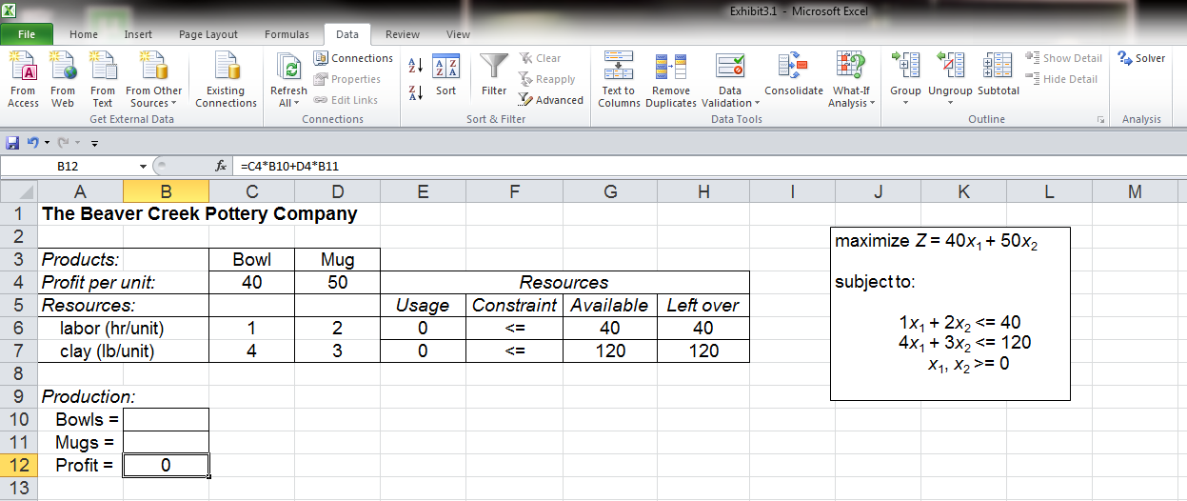
Beaver Creek Pottery Example
Excel Spreadsheet – Data Screen (1 of 5)
Click on “Data” tab to invoke “Solver.”
=C6*B10+D6*B11
=G6-E6
Decision variable—bowls (x₁)=B10; mugs (x₂)=B11
=G7-E7
=C7*B10+D7*B11
Objective function =C4*B10+D4*B11
Exhibit 3.1

Slide 5
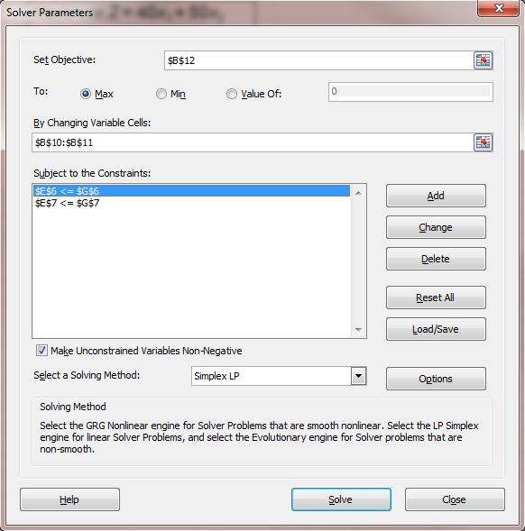
Beaver Creek Pottery Example
“Solver” Parameter Screen (2 of 5)
Objective function
Decision variables
Click on “Add” to add model contraints.
=C7*B10+D7*B11<20
=C6*B10+D6*B11<40
x₁, x₂ >0
Select “Simplex LP” method
Exhibit 3.2 Solver parameters

Slide 6
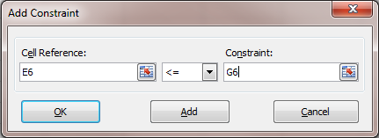
Beaver Creek Pottery Example
Adding Model Constraints (3 of 5)
=40
=C6*B10+D6*B11
Exhibit 3.3 Labor constraint

Slide 7
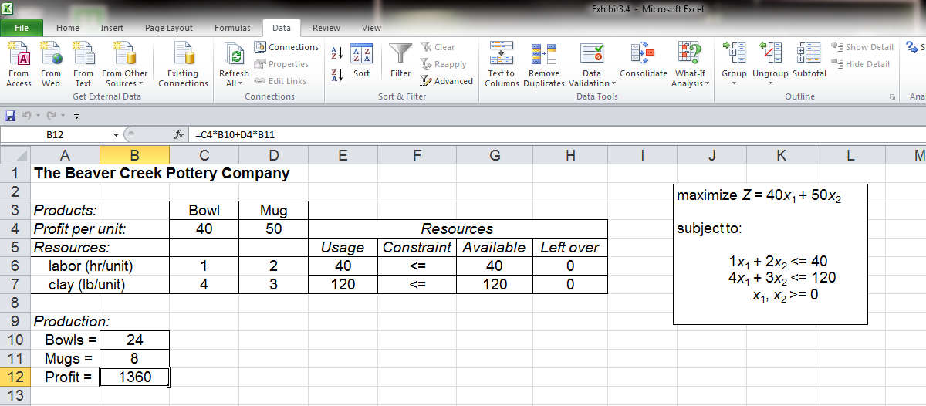
Beaver Creek Pottery Example
“Solver” Settings (4 of 5)
Slack—S₁=0 and S₂=0
Slack S₁ = 0
and S₂ = 0
Exhibit 3.4 Solution screen

Slide 8
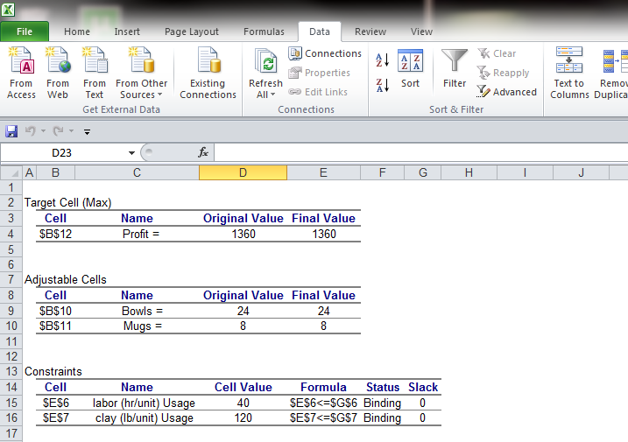
Beaver Creek Pottery Example
Solution Screen (5 of 5)
Exhibit 3.5 Answer report

Slide 9
Linear Programming Problem: Standard Form
Standard form requires all variables in the constraint equations to appear on the left of the inequality (or equality) and all numeric values to be on the right-hand side.
Examples:
x₃ ≥ x₁ + x₂ must be converted to x₃ - x₁ - x₂ ≥ 0
x₁/(x₂ + x₃) ≥ 2 becomes x₁ ≥ 2 (x₂ + x₃)
and then x₁ - 2x₂ - 2x₃ ≥ 0

Slide 10
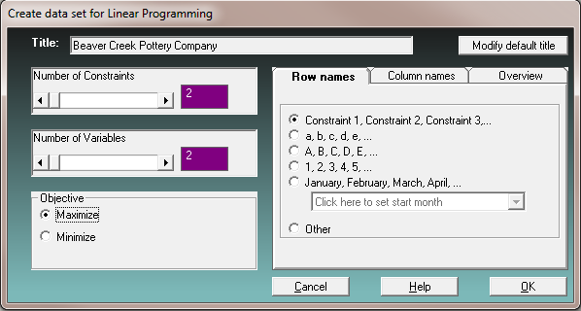
Beaver Creek Pottery Example
QM for Windows (1 of 4)
Set number of constraints and decision variables.
Click here when finished.
Exhibit 3.6 Data entry screen

Slide 11
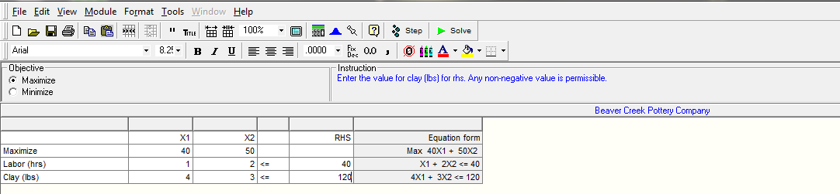
Beaver Creek Pottery Example
QM for Windows (2 of 4)
Exhibit 3.7 Data table

Slide 12
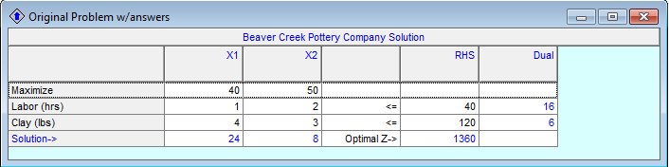
Beaver Creek Pottery Example
QM for Windows (3 of 4)
Exhibit 3.8 Model solution

Slide 13
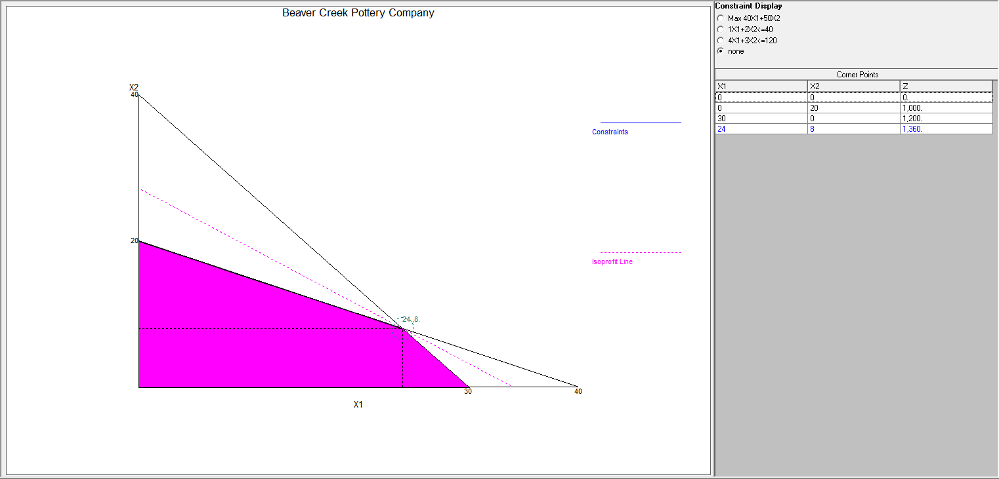
Beaver Creek Pottery Example
QM for Windows (4 of 4)
Exhibit 3.9 Graphical solution

Slide 14
Beaver Creek Pottery Example
Sensitivity Analysis (1 of 4)
Sensitivity analysis determines the effect on the optimal solution of changes in parameter values of the objective function and constraint equations.
Changes may be reactions to anticipated uncertainties in the parameters or to new or changed information concerning the model.

Slide 15
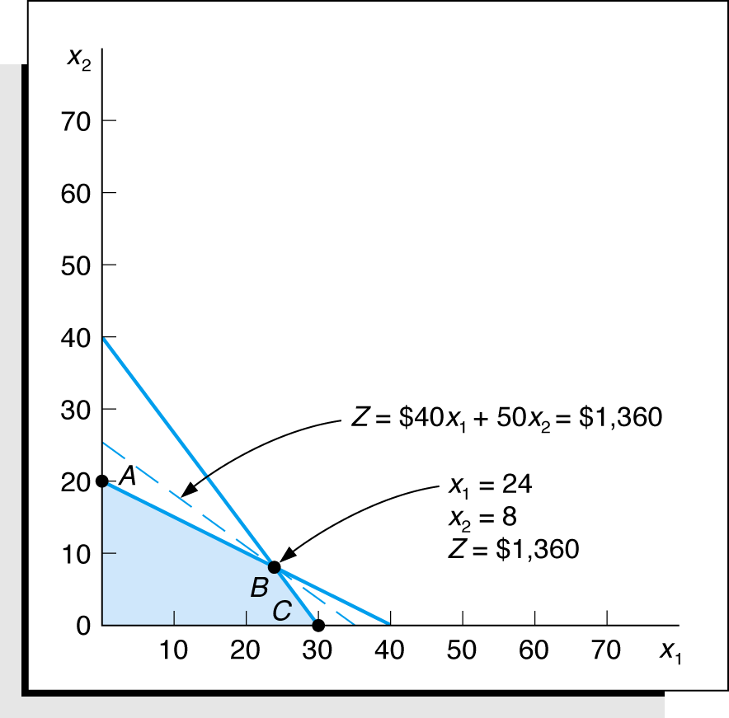
Beaver Creek Pottery Example
Sensitivity Analysis (2 of 4)
Maximize Z = $40x₁ + $50x₂
subject to: x₁ + 2x₂ ≤ 40
4x₁ + 3x₂ ≤ 120
x₁, x₂ ≥ 0
Figure 3.1
Optimal solution point

Slide 16
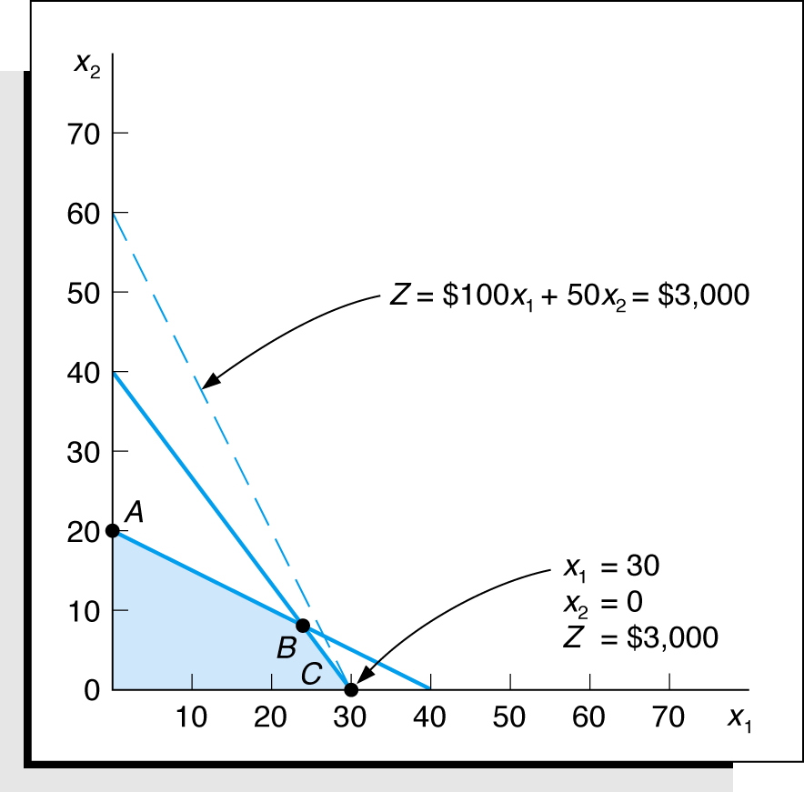
Beaver Creek Pottery Example
Change x₁ Objective Function Coefficient (3 of 4)
Maximize Z = $100x₁ + $50x₂
subject to: x₁ + 2x₂ ≤ 40
4x₁ + 3x₂ ≤ 120
x₁, x₂ ≥ 0
Figure 3.2 Changing the x₁ objective function coefficient

Slide 17
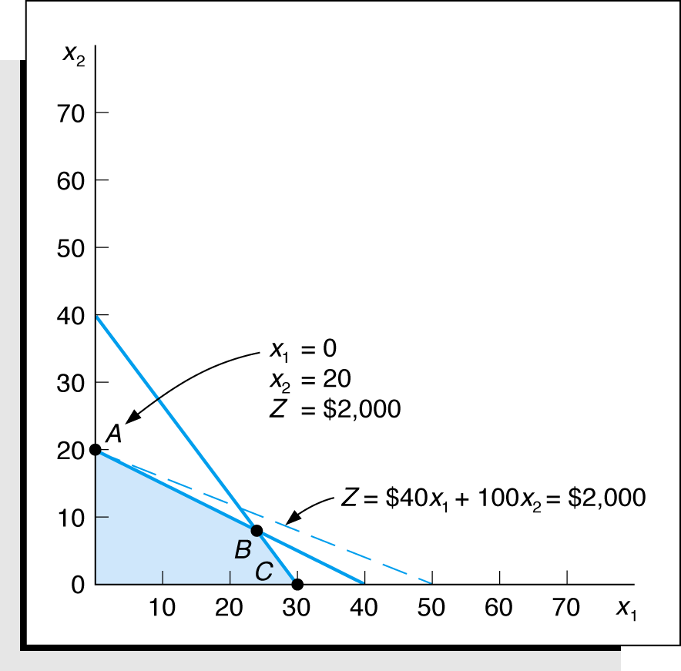
Beaver Creek Pottery Example
Change x₂ Objective Function Coefficient (4 of 4)
Maximize Z = $40x₁ + $100x₂
subject to: x₁ + 2x₂ ≤ 40
4x₁ + 3x₂ ≤ 120
x₁, x₂ ≥ 0
Figure 3.3 Changing the x₂ objective function coefficient

Slide 18
Objective Function Coefficient
Sensitivity Range (1 of 3)
The sensitivity range for an objective function coefficient is the range of values over which the current optimal solution point will remain optimal.
The sensitivity range for the x_{i} coefficient is designated as c_{i.}
objective function Z = $40x₁ + $50x₂
The slope of the objective function is -4/5 given by:
50X₂=Z-40X₁
X₂=Z/50 – 4/5X₁
If the slope of the objective function changes to -4/3, the line is parallel to the constraint line (next slide).

Slide 19
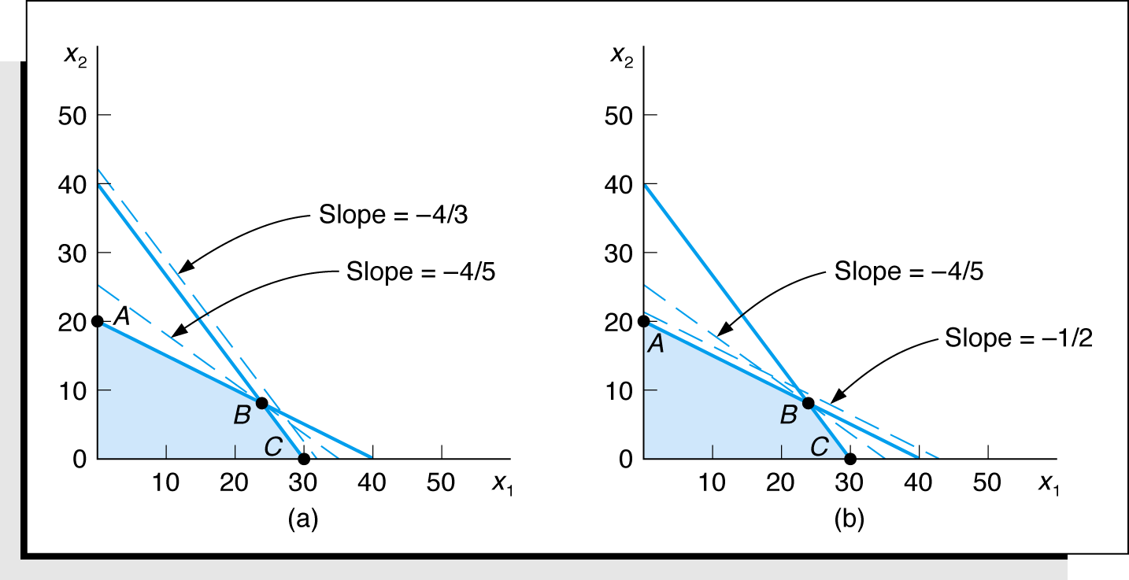
Objective Function Coefficient
Sensitivity Range for c₁ and c₂ (2 of 3)
objective function Z = $40x₁ + $50x₂ sensitivity range for:
x₁: 25 ≤ c₁ ≤ 66.67 x₂: 30 ≤ c₂ ≤ 80
Figure 3.4 Determining the sensitivity range for c₁

Slide 20
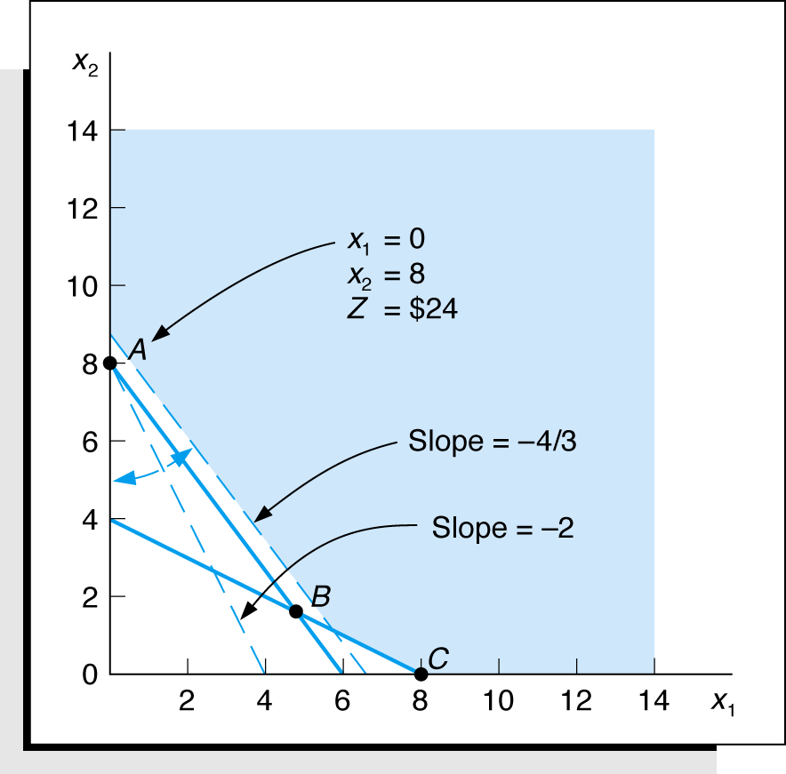
Objective Function Coefficient
Fertilizer Cost Minimization Example (3 of 3)
Minimize Z = $6x₁ + $3x₂
subject to:
2x₁ + 4x₂ ≥ 16
4x₁ + 3x₂ ≥ 24
x₁, x₂ ≥ 0
sensitivity ranges:
4 ≤ c₁ ≤ ∞
0 ≤ c₂ ≤ 4.5
Figure 3.5 Fertilizer example: sensitivity range for c₁

Slide 21
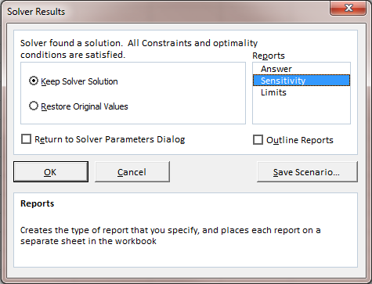
Objective Function Coefficient Ranges
Excel “Solver” Results Screen
Exhibit 3.10 Solver results screen

Slide 22
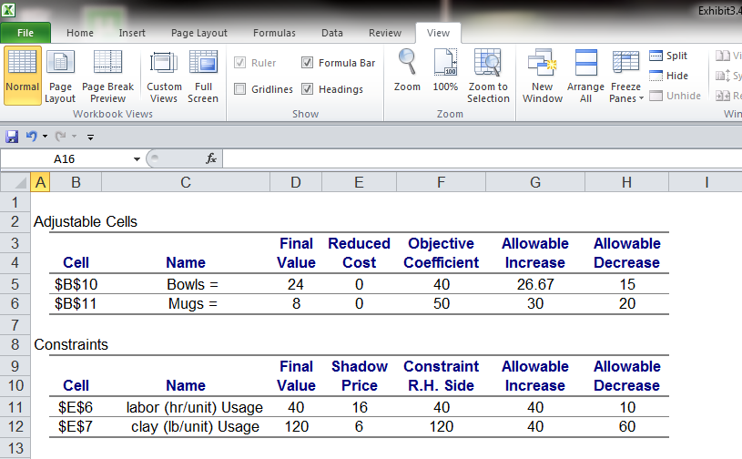
Objective Function Coefficient Ranges
Beaver Creek Example Sensitivity Report
Sensitivity ranges for objective function coefficients
Exhibit 3.11

Slide 23
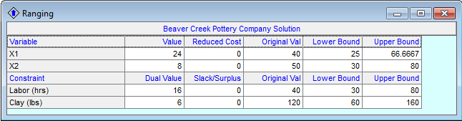
Objective Function Coefficient Ranges
QM for Windows Sensitivity Range Screen
Sensitivity ranges
for objective
function coefficients
Exhibit 3.12

Slide 24
Changes in Constraint Quantity Values
Sensitivity Range (1 of 4)
The sensitivity range for a right-hand-side value is the range of values over which the quantity’s value can change without changing the solution variable mix, including the slack variables.
Recall the Beaver Creek Pottery example. Consider a change in which the manager can increase labor hours from 40 to 60.

Slide 25
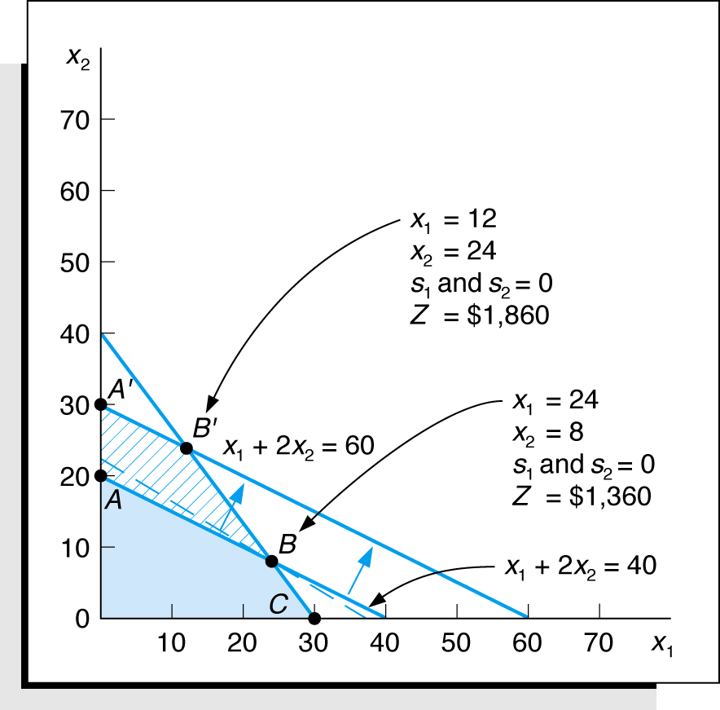
Changes in Constraint Quantity Values
Increasing the Labor Constraint (2 of 4)
Original formulation with 40 hours labor
Maximize Z = $40x₁ + $50x₂
subject to: x₁ + 2x₂ + s₁ = 40
4x₁ + 3x₂ + s₂ = 120
x₁, x₂ ≥ 0
Figure 3.6 Increasing the labor constraint quantity

Slide 26
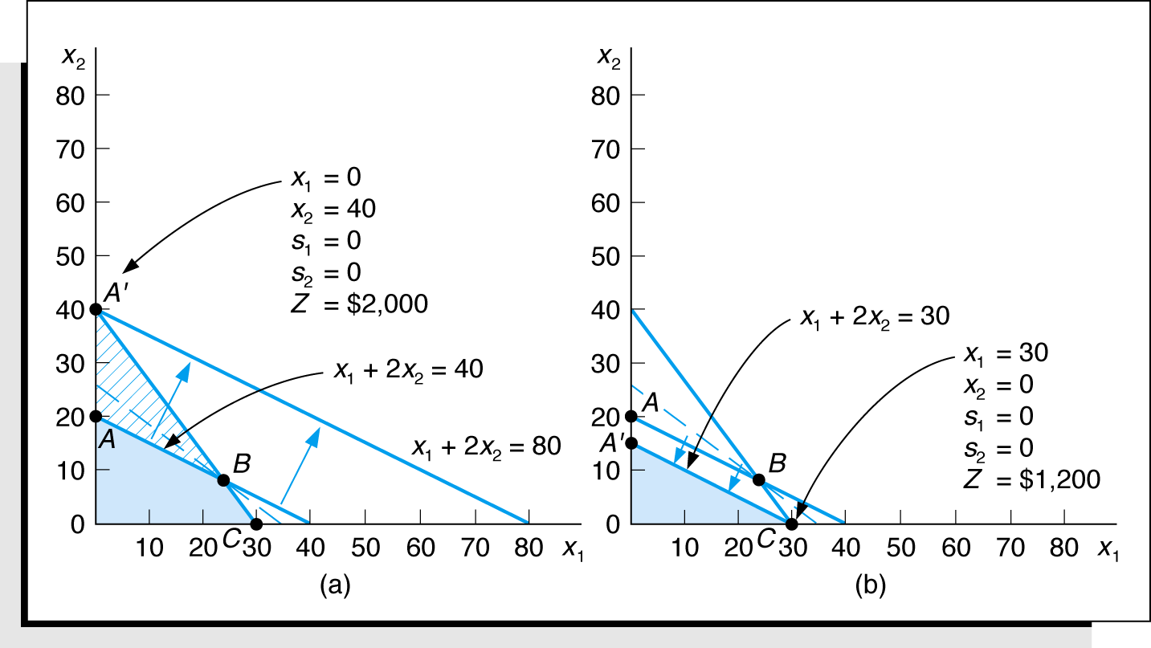
Changes in Constraint Quantity Values
Sensitivity Range for Labor Constraint (3 of 4)
Figure 3.7 Determining the sensitivity range for labor quantity

Slide 27
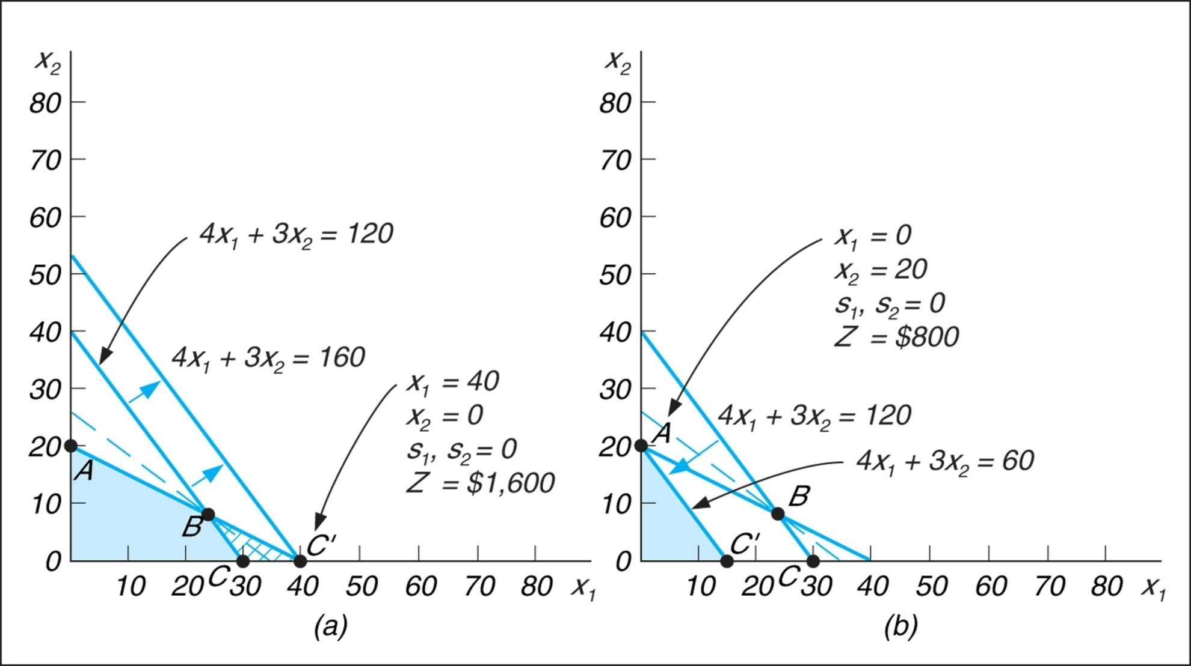
Changes in Constraint Quantity Values
Sensitivity Range for Clay Constraint (4 of 4)
Figure 3.8 Determining the sensitivity range for clay quantity

Slide 28

Constraint Quantity Value Ranges by Computer
Excel Sensitivity Range for Constraints (1 of 2)
Sensitivity ranges for constraint quantity values
Exhibit 3.13

Slide 29

Constraint Quantity Value Ranges by Computer
QM for Windows Sensitivity Range (2 of 2)
Sensitivity ranges for constraint quantity values
Exhibit 3.14

Slide 30
Other Forms of Sensitivity Analysis
Topics (1 of 4)
Changing individual constraint parameters
Adding new constraints
Adding new variables

Slide 31
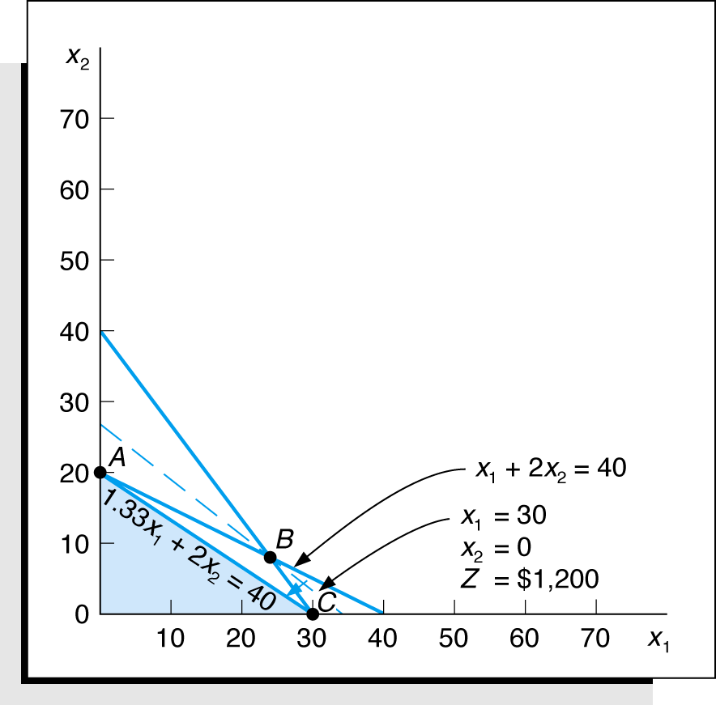
Other Forms of Sensitivity Analysis
Changing a Constraint Parameter (2 of 4)
Maximize Z = $40x₁ + $50x₂
subject to: x₁ + 2x₂ ≤ 40
4x₁ + 3x₂ ≤ 120
x₁, x₂ ≥ 0
Figure 3.9 Changing the x₁ coefficient in the labor constraint

Slide 32
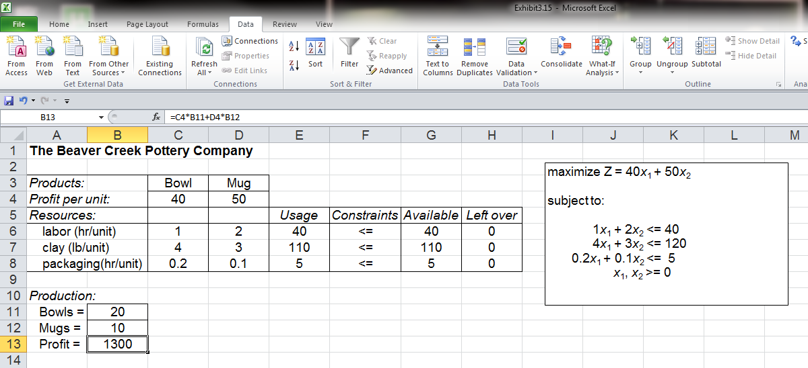
Other Forms of Sensitivity Analysis
Adding a New Constraint (3 of 4)
Adding a new constraint to Beaver Creek Model: 0.20x₁+ 0.10x₂ ≤ 5 hours for packaging Original solution: 24 bowls, 8 mugs, $1,360 profit
Added constraint for packaging
Constraint E8 ≤ G8 added to Solver
Exhibit 3.15

Slide 33
Other Forms of Sensitivity Analysis
Adding a New Variable (4 of 4)
Adding a new variable to the Beaver Creek model, x₃, for a third product, cups
Maximize Z = $40x₁ + 50x₂ + 30x₃
subject to:
x₁ + 2x₂ + 1.2x₃ ≤ 40 hr of labor
4x₁ + 3x₂ + 2x₃ ≤ 120 lb of clay
x₁, x₂, x₃ ≥ 0
Solving model shows that change has no effect on the original solution (i.e., the model is not sensitive to this change).

Slide 34
Shadow Prices (Dual Variable Values)
Defined as the marginal value of one additional unit of resource.
The sensitivity range for a constraint quantity value is also the range over which the shadow price is valid.

Slide 35
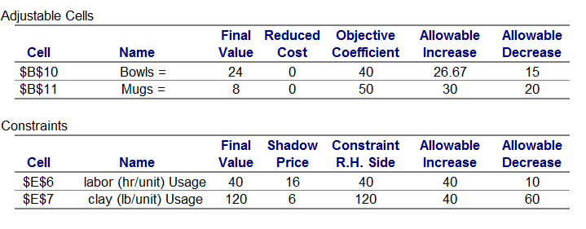
Excel Sensitivity Report for Beaver Creek Pottery
Shadow Prices Example (1 of 2)
Maximize Z = $40x₁ + $50x₂ subject to:
x₁ + 2x₂ ≤ 40 hr of labor
4x₁ + 3x₂ ≤ 120 lb of clay
x₁, x₂ ≥ 0
Shadow prices (dual values)
Exhibit 3.16

Slide 36
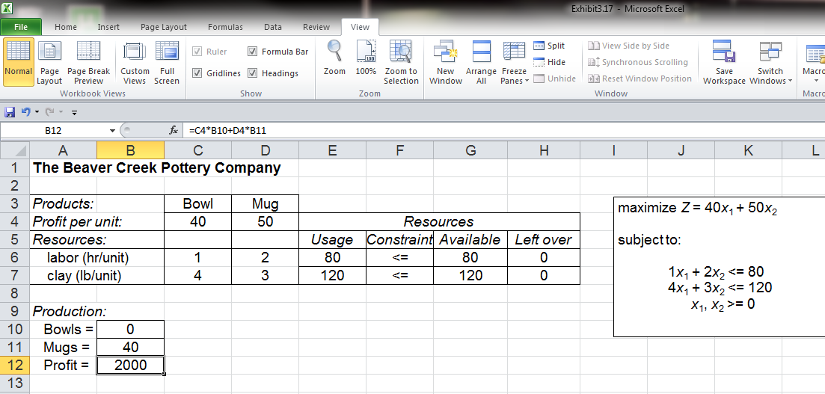
Excel Sensitivity Report for Beaver Creek Pottery
Solution Screen (2 of 2)
Increase in labor hours from
40 to 80
Increase in profit from $1,360 to $2,000
Exhibit 3.17

Slide 37
Example Problem
Problem Statement (1 of 3)
Two airplane parts: no.1 and no. 2.
Three manufacturing stages: stamping, drilling, finishing.
Decision variables: x₁ (number of part no. 1 to produce)
x₂ (number of part no. 2 to produce)
Model: Maximize Z = $650x₁ + 910x₂
subject to:
4x₁ + 7.5x₂ ≤ 105 (stamping,hr)
6.2x₁ + 4.9x₂ ≤ 90 (drilling, hr)
9.1x₁ + 4.1x₂ ≤ 110 (finishing, hr)
x₁, x₂ ≥ 0

Slide 38
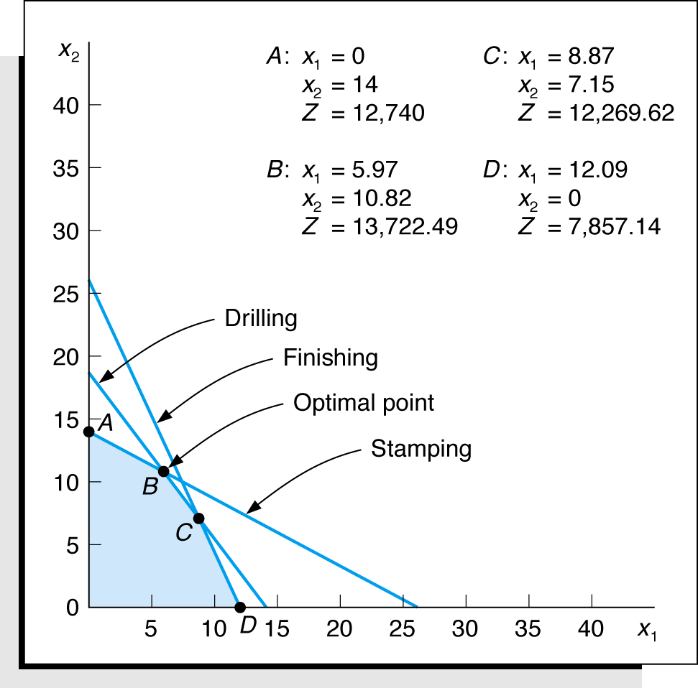
Example Problem
Graphical Solution (2 of 3)
Maximize Z = $650x₁ + $910x₂
subject to:
4x₁ + 7.5x₂ ≤ 105
6.2x₁ + 4.9x₂ ≤ 90
9.1x₁ + 4.1x₂ ≤ 110
x₁, x₂ ≥ 0
s1 = 0, s2 = 0, s3 = 11.35 hr
485.33 ≤ c₁ ≤ 1,151.43
89.10 ≤ q₁ ≤ 137.76

Slide 39
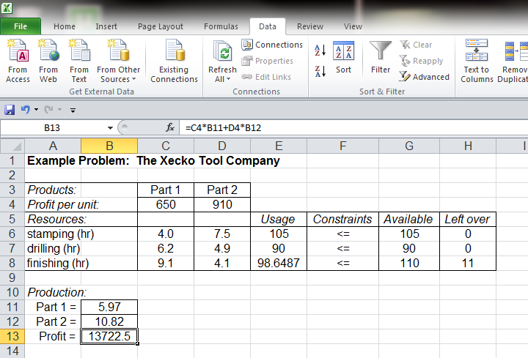
Example Problem
Excel Solution (3 of 3)

